Slide 1
Breakout activity Linkedin profile pic
GITHUB PROJECT team -J
2620080042-Vineeth kumar
2620080063-Jeyanth vighnesh(team leader)
2620030516-Naga sai ajay
2620030513-Pranil

Slide 2
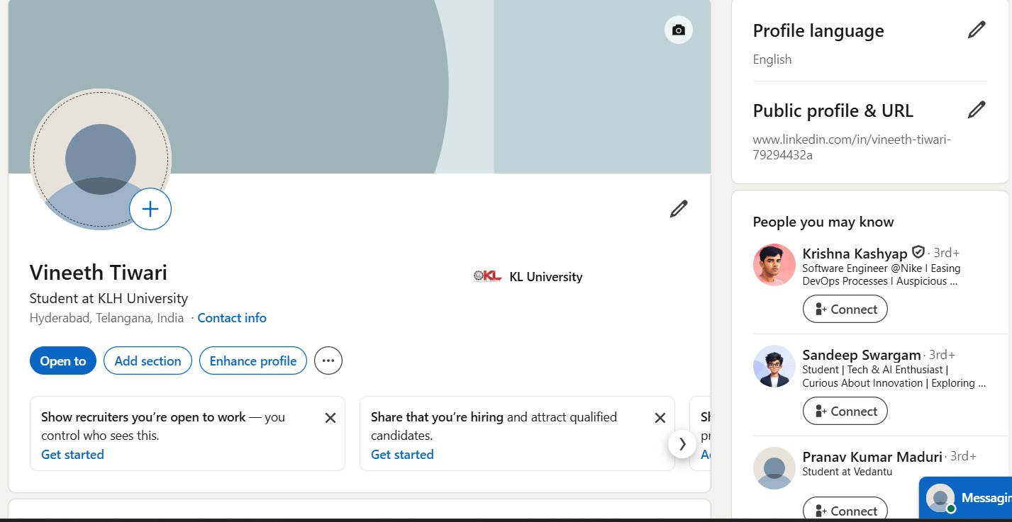
Vineeth Tiwari(2620080042)

Slide 3
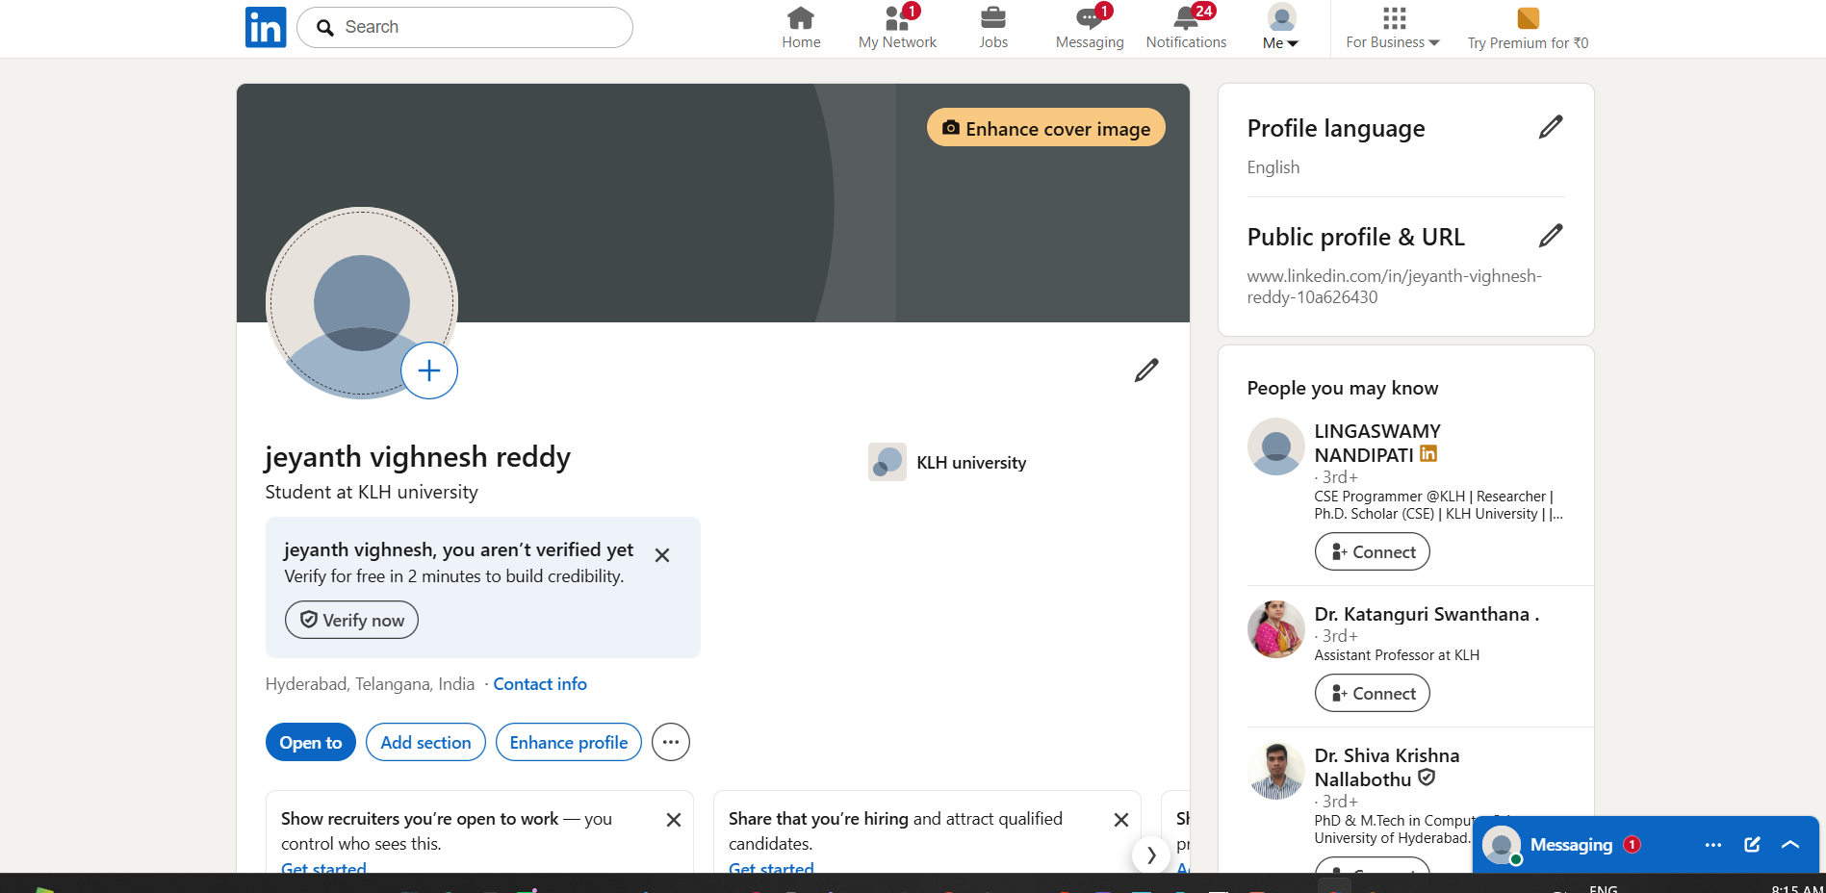
2620080063-Jeyanth vighnesh(team leader)

Slide 4

2620030516-Naga sai ajay

Slide 5
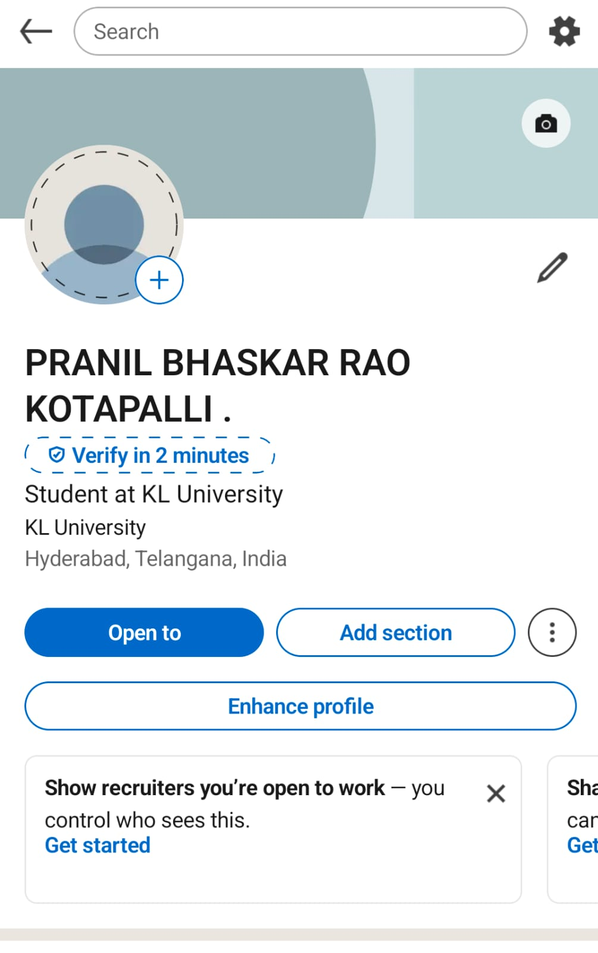
2620030513-Pranil

